Slide 1
DS 210 Intro to Data Science SPRING 2025 Boston Housing
Erica Volden

Slide 2
Introduction
Can nitric oxide levels be predicted by the proportion of non-retail business acres per town?
US Census Data Boston Massachusetts, 1978
506 Cities, 14 Features
modified_BostonHousing.csv Modified by Alice Chen
https://www.cs.toronto.edu/~delve/data/boston/bostonDetail.html

Slide 3
Feature Details
CRIM - per capita crime rate by town
ZN - proportion of residential land zoned for lots over 25,000 sq.ft.
INDUS - proportion of non-retail business acres per town.
CHAS - Charles River dummy variable (1 if tract bounds river; 0 otherwise)
NOX - nitric oxides concentration (parts per 10 million)
RM - average number of rooms per dwelling
AGE - proportion of owner-occupied units built prior to 1940
DIS - weighted distances to five Boston employment centers
RAD - index of accessibility to radial highways
TAX - full-value property-tax rate per $10,000
PTRATIO - pupil-teacher ratio by town
B - 1000(Bk - 0.63)^2 where Bk is the proportion of blacks by town
LSTAT - % lower status of the population
MEDV - Median value of owner-occupied homes in $1000's
Note:
Variable #14 seems to be censored at 50.00 (corresponding to a median price of $50,000); Censoring is suggested by the fact that the highest median price of exactly $50,000 is reported in 16 cases, while 15 cases have prices between $40,000 and $50,000, with prices rounded to the nearest hundred. Harrison and Rubinfeld do not mention any censoring.”

Slide 4
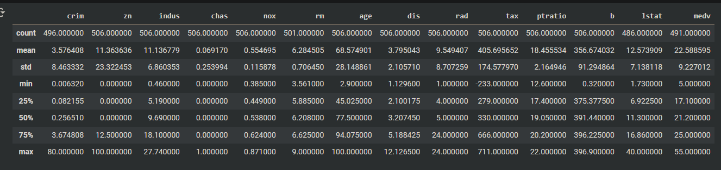
Exploratory Data Analysis
Import/Read in CSV
Describe
Sort Values
Outliers
Tax
B
Crim, Zn
Medv

Slide 5
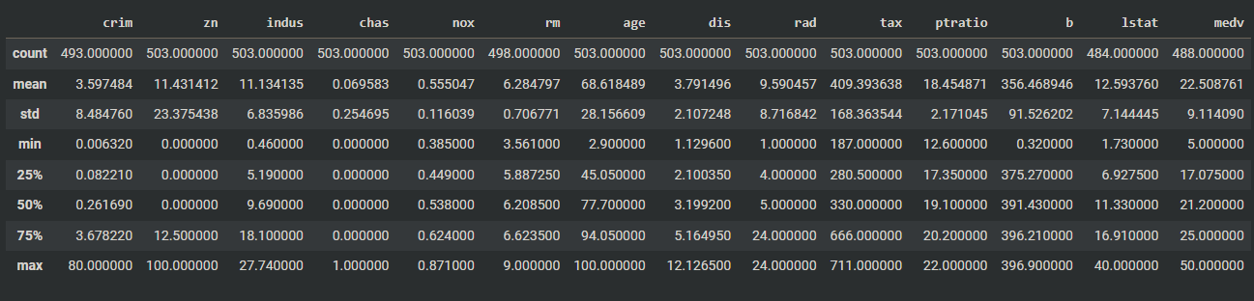
Exploratory Data Analysis
Missing/Null values
Is Null
Sort Values
Fill na

Slide 6
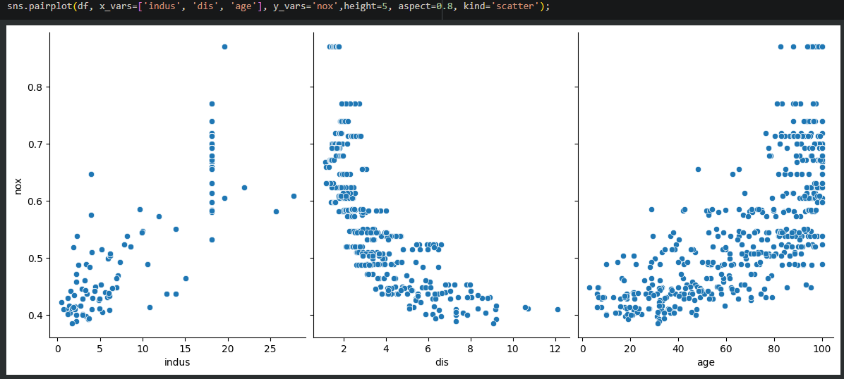
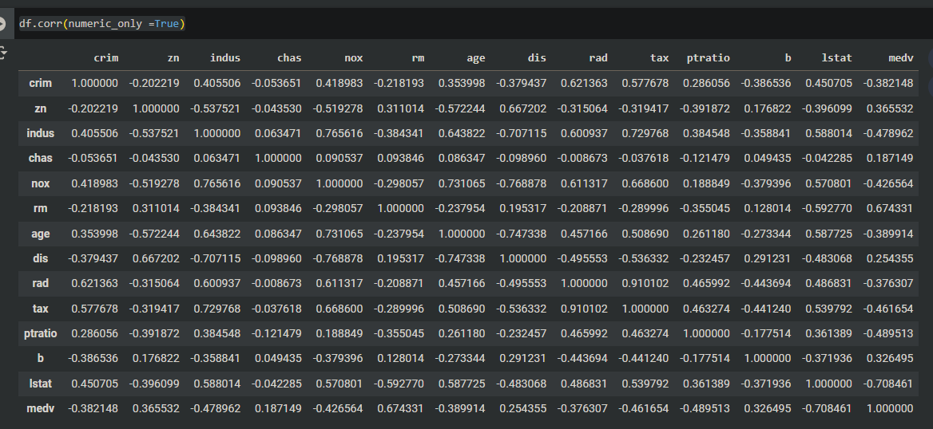
Exploratory Data Analysis
Correlation Table
Pairplot

Slide 7
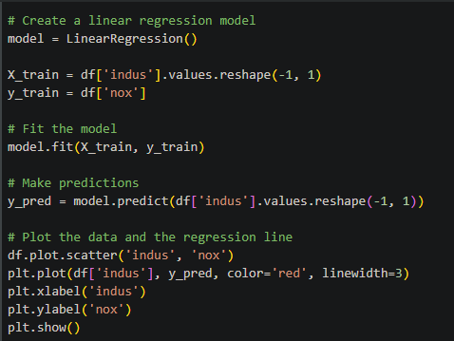
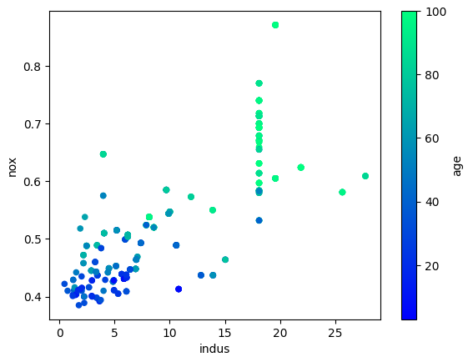
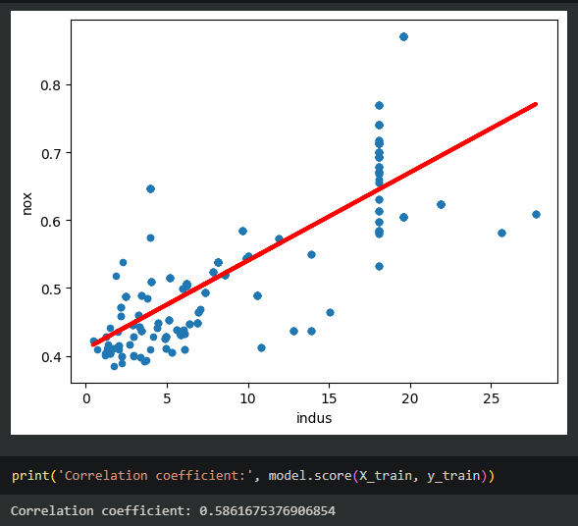
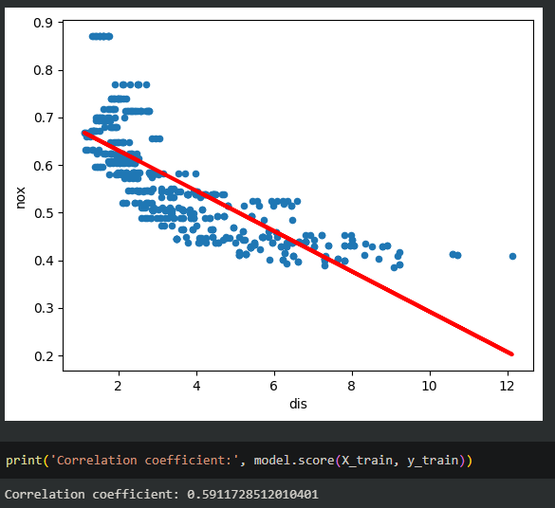
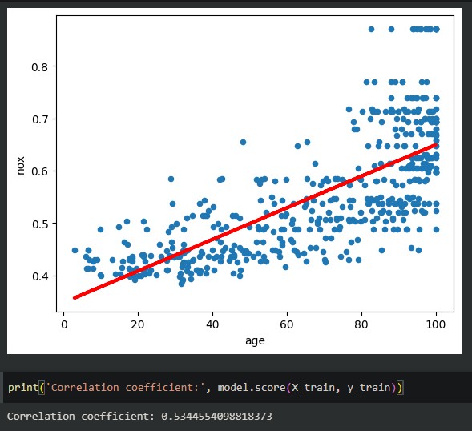
Exploratory Data Analysis
Linear Regression Model
Correlation Coefficient

Slide 8
Refining the Question
Data Science Lifecycle
Original Question
Can nitric oxide levels (NOX) be predicted by the proportion of non-retail business acres per town (INDUS)?
New Question
Can nitric oxide concentration levels (NOX) be predicted by the weighted distances to five Boston employment centers (DIS)?

Slide 9
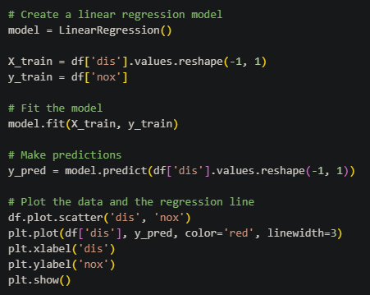
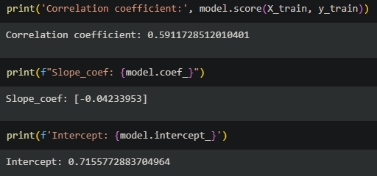
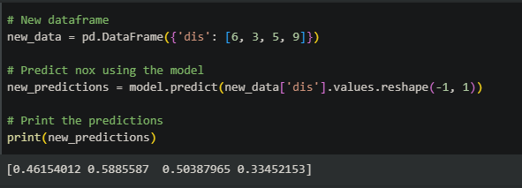
Model Building
Y = mx + b Y = -0.0423 * 6 + 0.7156

Slide 10
Interpretation/Summary
Can nitric oxide concentration levels (NOX) be predicted by the weighted distances to five Boston employment centers (DIS)?

